Slide 1
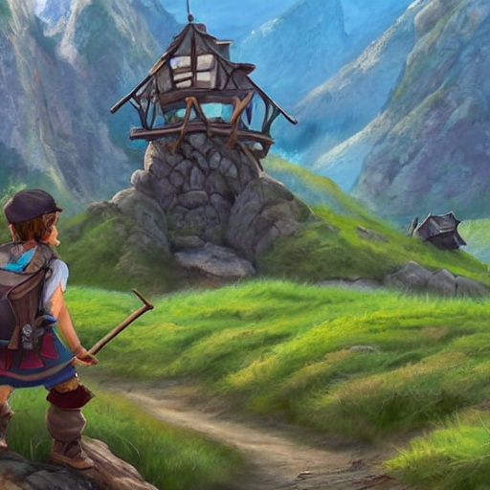
Introduction Mini Project

Slide 2
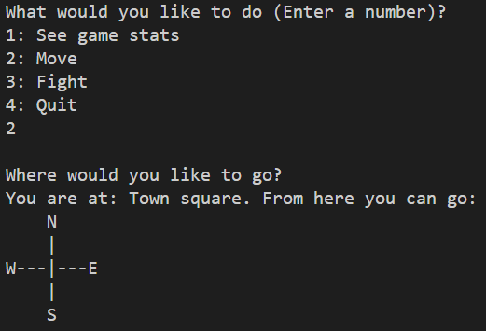
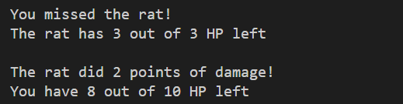
Simple RPG (Role Playing Game)

Slide 3
Goal
Hands-on experience with:
Scrum
C#

Slide 4
Deadline
Project lesson Week 3.2

Slide 5
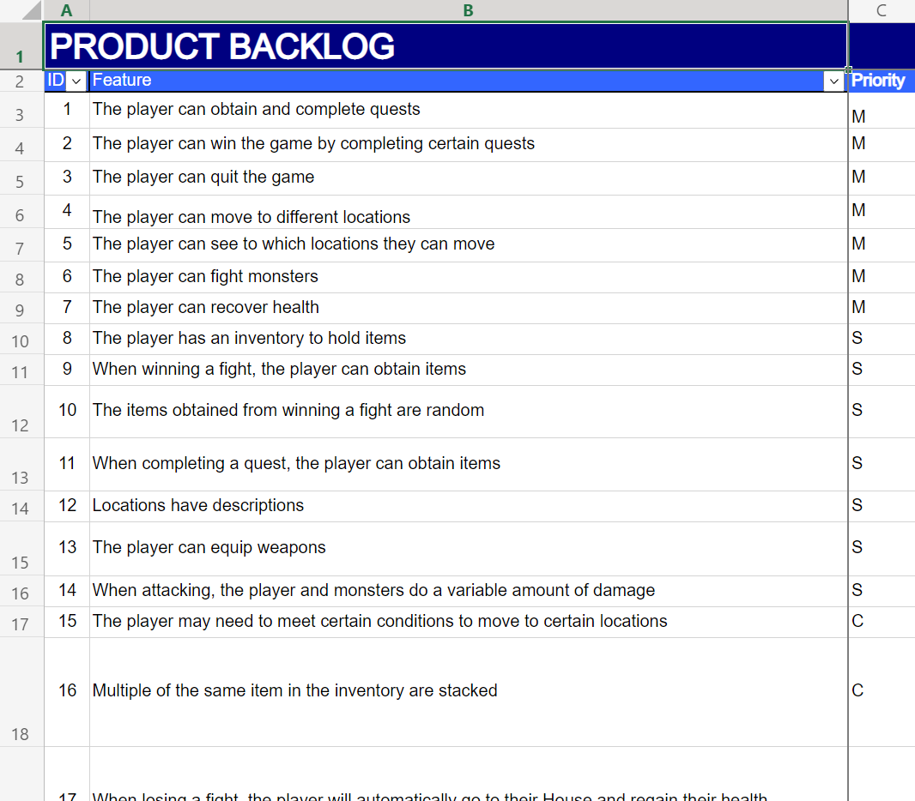
Product backlog (will be shared)

Slide 6
Product backlog
Project is designed to be large
You probably won’t complete it
This is fine!

Slide 7
Mini Project
Duration: 2 weeks
Given the backlog:
Select features
Divide amongst the team
Implement (+ merge, test & review)

Slide 8
Code base (will be shared)
World.cs is used to create:
Locations
Monsters
Items
Weapons
Quests

Slide 9
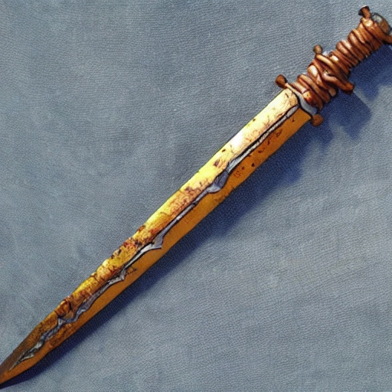
The Hero
You start off with a rusty sword
Serviceable, but perhaps you could find a better weapon?

Slide 10
The game
The people in your town are being terrorized by giant spiders. You decide to do what you can to help.
Objective: complete all quests
Map:
Map with locations:
|
|
--+---
|
P
A
VFTGBS
H

Slide 11
The game
Legend:
H: Your house (game start)
T: Town square
F: Farmer
V: Farmer’s field
A: Alchemist’s hut
P: Alchemist’s garden
G: Guard post
B: Bridge
S: Spider forest
P
A
VFTGBS
H

Slide 12

Quest: Clear the farmer’s field
P
A
VFTGBS
H
Given by Farmer (F)
Kill snakes in the farmer’s field (V)
Return to the Farmer with 3 Snake fangs
Removed from inventory
Reward: Adventurer’s Pass
Allows entry to the Bridge (B)
“I can't w'rk mine own landeth with those pesky snakes slith'ring 'round! Shall thee holp me?”

Slide 13
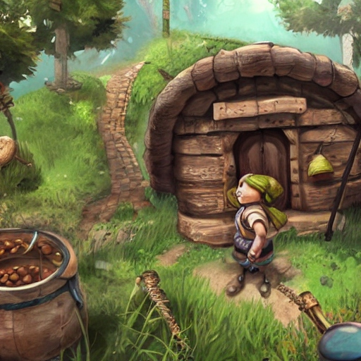
Quest: Clear the alchemist’s garden
P
A
VFTGBS
H
Given by Alchemist (A)
Kill rats in the alchemist’s garden (P)
Return to the Alchemist with 3 Rat tails
Removed from inventory
Reward: a Club
“Those rats art nibbling on mine own h'rbs! I couldst very much useth an adventur'r to taketh careth of those folk …”

Slide 14
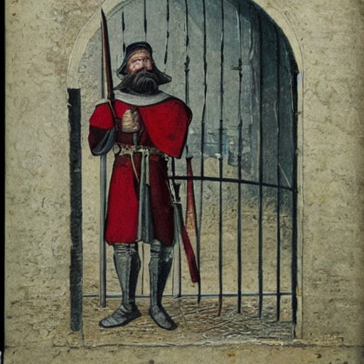
Guard’s post
P
A
VFTGBS
H
You need the Adventurer’s Pass to proceed to the bridge
“Turn back at once, peasant! Unless thee hast proof of thy grit.”

Slide 15
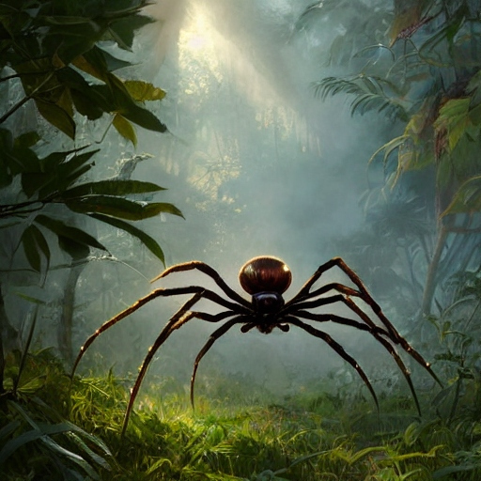
Quest: Collect spider silk
P
A
VFTGBS
H
Received when reaching the bridge (B)
Kill spiders in the spider forest (S)
Return to the bridge with 3 Spider silks
Removed from inventory
Reward: the Winner’s Medal
“I shalt releaseth the town folks of their feareth!”

Slide 16
Demonstration
In Week 3.2, you will hand in the Mini Project
You will also give a demo

Slide 17
Constraints
Must be built in C# (.NET 6)
Must be console-based
GitHub must be used
Scrum must be used
VSCode/VS must be used
World.cs must be used as a code base
Must be built using OO

Slide 18
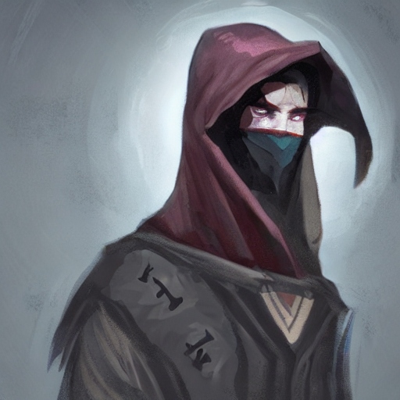
Questions?
The dungeon master shall provide thou with answers

Slide 19
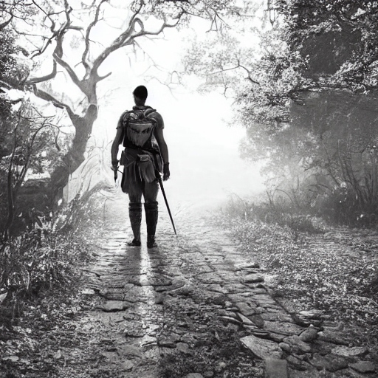
Embark on thy quest, adventur'r!
All illustrations created using deepai.org

